Slide 1

WELCOME
history
To Our Presentation
follow
services
teams
timeline
about

Slide 2
Presentation Topic
Online Tutor Management System
follow
history
services
teams
timeline
Team

Slide 3
TEAM MEMBERS
history
MEHEDI HASAN
TARIKUL ISLAM
follow
teams
services
timeline
Team
ID: 163432507
ID: 163432568
Batch: 43rd
CSE Department
Batch: 43rd
CSE Department

Slide 4
Online Tutoring Management System: A unique cloud based tutoring management system for both tutor and students. The primary target of this design is to make tuition experience on online platform. The Tutoring Management System includes registration of tutors and students, storing their details into the system and also automatically grouping the tutors according their qualifications and their location. So students can search their desire subjects related teacher easily. Students have the choice to get tuition on online.
follow
Introduction
services
teams
timeline
about

Slide 5
Various management programs for management are present out there but there are not so many which provides the students any functionality. The Tuition Service management has been automated but the benefit is for all like tutor, students and the guardians. In such a situation we have figured out that there should be something for the students and tutors. Some simple features for hiring tutor, asking for tuition, finding male or female as required in an acceptable salary, location choosing, tuition from home, institution or online. It can reduce the hassle up to 80-90%.
Background History
follow
history
services
teams
about

Slide 6
There are so many existing software behind our project. Such as,
https://www.tutorialpoints.com
https://www.geeksforgeeks.org
https://www.studytonight.com
https://www.khanacademy.org
etc.
follow
Existing software
history
services
timeline
about

Slide 7
Hardware & Software requirement
Software requirement:
Operating System
Xampp
MySQL
Internet Browser
Requirement Analysis
follow
history
about
Hardware Requirement:
Processor
Memory Space
Monitor
RAM
Others i/o devices

Slide 8
Others Requirement Analysis
System-Level Data Recovery
Application-Level Data Recovery
Application Data Availability
Multi-Level Data Security
Scalability: Users, Transactions, Data
DBMS Autonomics and Process Automation
Interoperability
Requirement Analysis
services
history
teams
timeline
about

Slide 9
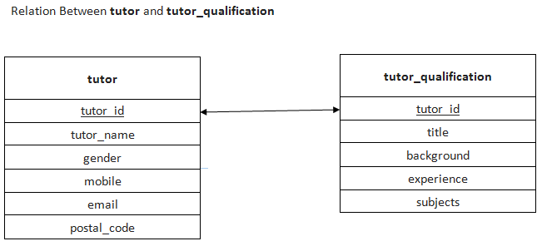
Relational MOdel
history
services
teams
timeline
about

Slide 10
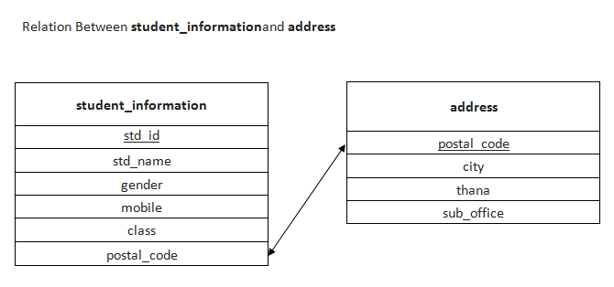
Relational MOdel
history
services
teams
timeline
about

Slide 11
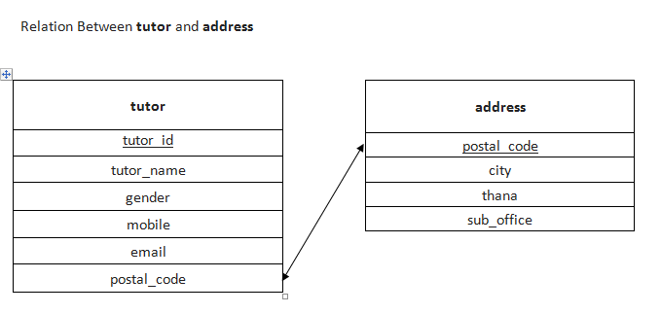
Relational MOdel
history
services
teams
timeline
about

Slide 12
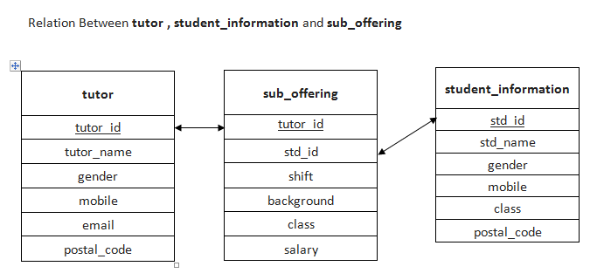
Relational MOdel
history
services
teams
timeline
about

Slide 13
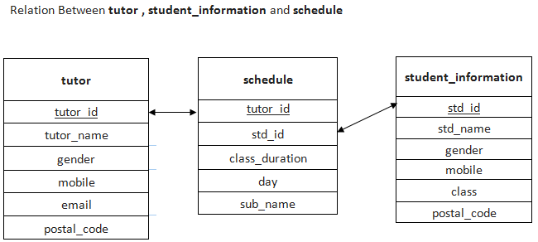
Relational MOdel
services
history
teams
timeline
about

Slide 14
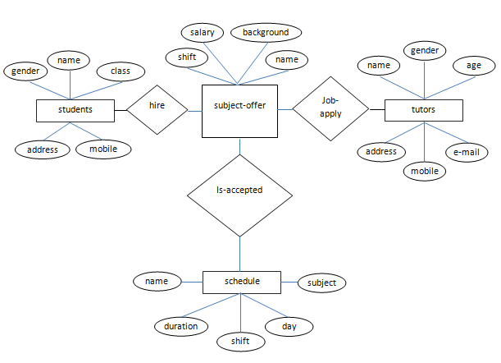
E-R Diagram
history
services
teams
timeline
about

Slide 15
Q1: Find the name of tutors gender is Male.
SQL: SELECT `tutor_name` FROM `tutor` WHERE `gender`="male";
Q2: Find the tutors who’s name start with S.
SQL: SELECT `tutor_name` FROM `tutor` WHERE `tutor_name` LIKE "S%";
Q3: Write the SQL of tutor who’s age between 25 to 30.
SQL: SELECT `tutor_name`,`age` FROM `tutor` WHERE `age` BETWEEN 25 and 30;
Q4: Write the SQL query that will show the age as Tutor_Age.
SQL: SELECT `tutor_name`,`age` as Tutor_Age FROM `tutor`;
Q5: Find the tutor name from Science background.
SQL: SELECT `tutor_name`,background FROM `tutor` NATURAL JOIN
tutor_qualification WHERE background="science";
SQL Query
history
services
teams
timeline
about

Slide 16
d
Q6.Write an SQL to find the tutor who has above 2 years of experiences.
SQL: SELECT `tutor_name`,experience FROM `tutor` NATURAL JOIN tutor_qualification WHERE experience >= 2;
Q7.Find the tutors name , postal code who lives in Dhaka City.
SQL: SELECT `tutor_name`,`postal_code` FROM `tutor` NATURAL JOIN `address` WHERE city="Dhaka";
Q8.Find student name, class , mobile who took offer in morning shift.
SQL: SELECT `std_name`,`class`,`mobile`,shift FROM `student_information` as s
LEFT JOIN sub_offering as o ON s.`std_id`=o.`std_id` WHERE shift="Morning";
Q9.Find the name and salary all tutors who earn more than 10000
SQL: SELECT tutor_name,`salary` FROM `sub_offering` NATURAL JOIN tutor
WHERE `salary`>=10000;
SQL Query
history
services
teams
timeline
about

Slide 17
d
Advantages
Parents & Students can easily find tutors of their requirements.
Finding tutors is so easy & comfortable by online tutor management platform, that’s saves everyone time.
It’s Just need a click for hiring a tutor.
Parents & students can choose among qualified tutors.
Students can choose their suitable tuition schedule.
Either students or tutors can cancel their tuition if they want.
Advantages
history
services
teams
timeline
about

Slide 18
d
Disadvantages
There is no such disadvantage of online tuition service. But the administrators of the Database can play an important rule to provide best or bad services.
Disadvantages
history
services
teams
timeline
about

Slide 19
00
d
Future Scope/Plan
Online tutor service can provide a large amount of tutor for the welfare of the students. We want to gather all the tutors and students who want a qualified tutors or student. If we can do that, tutors can self-employed as well as students can get best education. There are many talented students who are studying in honors , masters stages can distribute their talent by tutoring and earn money easily.
history
timeline
services
teams
about

Slide 20
d
Conclusion
After all it’s a huge project to accomplish. It can develop or upgrade day by day when necessary. We believe that it can break the old idea or system of tutoring in this modern world. We should welcome this modern system and will cope up with it.
history
Conclusion
services
teams
timeline
about

